Slide 1
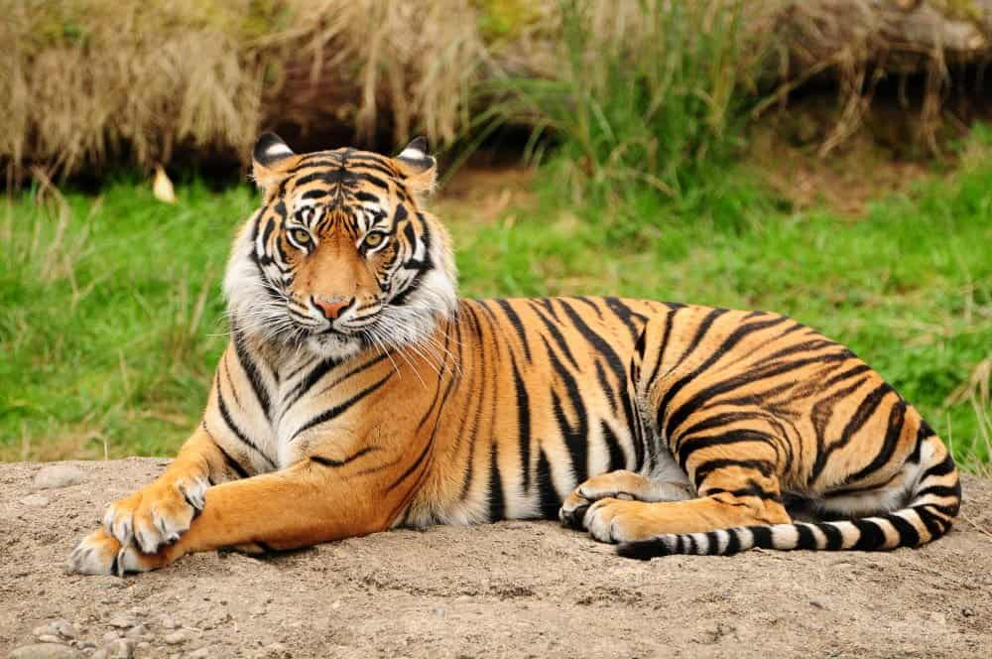
Animal Image Classification using Deep Learning
Using Transfer Learning with MobileNetV2
Presented by: Atish Sanap

Slide 2
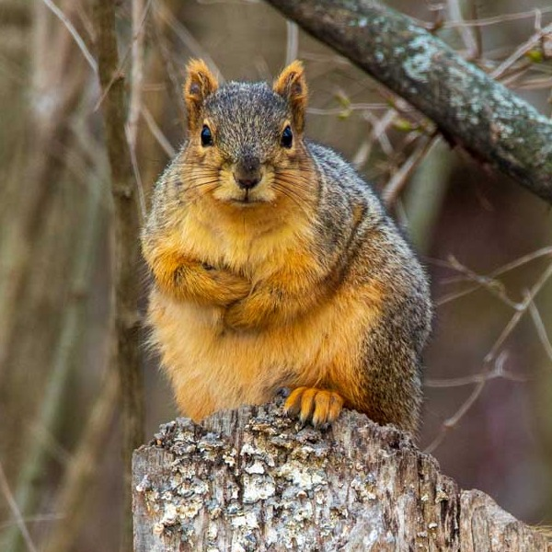
Contents of Project
Objective
Dataset Overview
Tools & Technologies
Model Architecture
Methodology
Training Results
Model Outcome
Conclusion

Slide 3
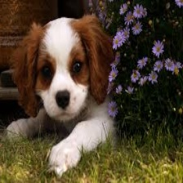
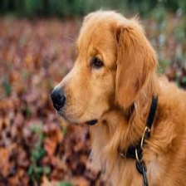
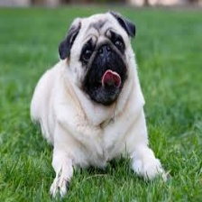
Objective:
To build an automated system capable of identifying animals in images. The goal is to correctly classify an image into one of 15 predefined animal categories using image processing and machine learning techniques.

Slide 4
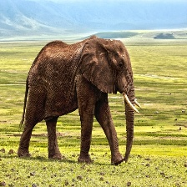
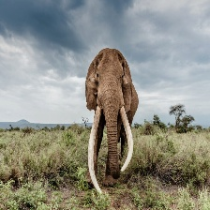
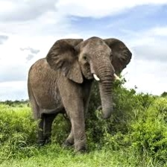
Problem Statement:
Manual identification of animals in images is time-consuming and prone to errors. Automating this process through machine learning can greatly improve the speed and accuracy of classification, especially in large datasets or wildlife monitoring systems.

Slide 5
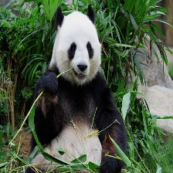
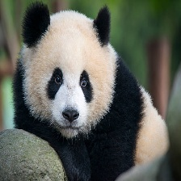
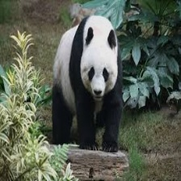
Dataset Details:
Total Classes: 15 animal categories
Image Size: 224 x 224 pixels, RGB (3 channels)
Folder Structure: Each folder represents one animal class
Classes:
Bear, Bird, Cat, Cow, Deer
Dog, Dolphin, Elephant, Giraffe, Horse
Kangaroo, Lion, Panda, Tiger, Zebra

Slide 6
Tools & Technologies
Programming Language: Python
Libraries:
TensorFlow & Keras (for deep learning models)
OpenCV (image manipulation)
NumPy & Pandas (data handling)
Matplotlib & Seaborn (visualizations)
Development Environment:
VS Code, Jupyter Notebook or Google Colab

Slide 7
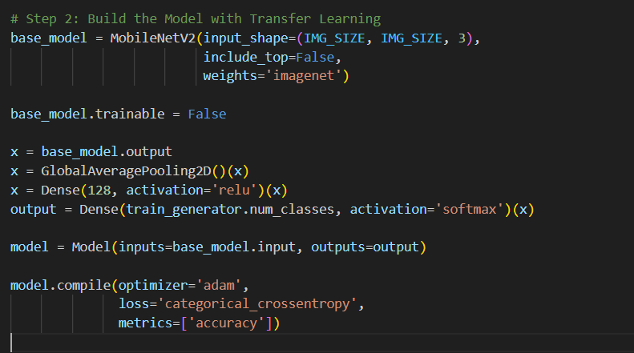
Model Architecture
Custom CNN:
Layers: Convolution → ReLU → Pooling → Dropout → Dense
Final layer with softmax activation for multiclass classification.
Transfer Learning:
Pretrained model (e.g., VGG16, ResNet50)
Freeze base layers, add custom dense layers on top
Trained faster and achieved better generalization

Slide 8
Methodology
Data Preprocessing:
Resize images to 224x224
Normalize pixel values
One-hot encode labels
Model Building:
Design a CNN model from scratch OR
Use pretrained models with Transfer Learning
Model Training:
Use training data with validation split
Monitor accuracy and loss metrics
Model Evaluation:
Evaluate performance using accuracy, precision, recall, and confusion matrix on test data
Prediction & Visualization:
Predict class of new animal images
Display image with predicted label
Data Preprocessing
Model Building
Model Training
Model Evaluation
Prediction & Visualization

Slide 9
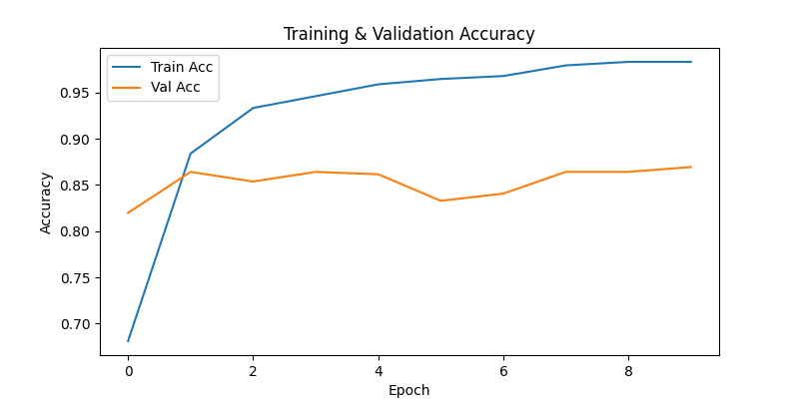
Training Results
Training Accuracy: Reached high values (e.g., >90% depending on model and epochs)
Validation Accuracy: Tracked to monitor overfitting
Loss Curves: Plotted training vs. validation loss across epochs

Slide 10
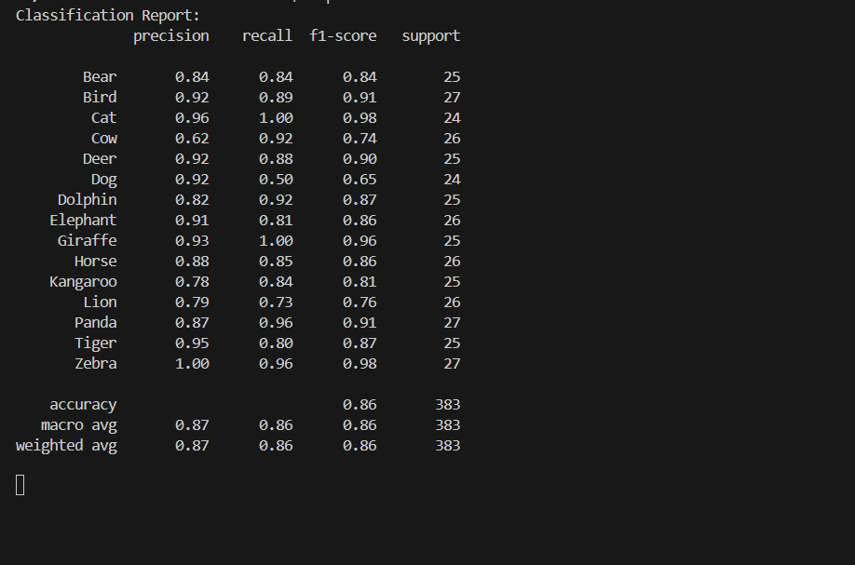
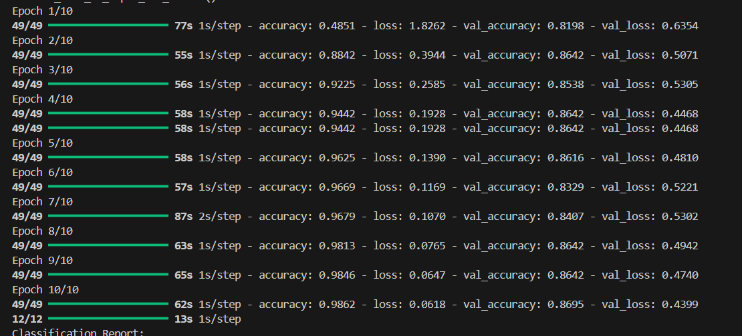
Model Outcome
A trained model that can accurately classify an animal image into one of the 15 given categories with high accuracy, ideally above 90%.

Slide 11
Conclusion
Successfully built an end-to-end image classification model. Demonstrated the effectiveness of CNNs and transfer learning. Validated the model’s performance using real-world metrics. Open to improvements in data, model, and deployment strategy.

Slide 12
Thank You !!!

